Slide 1
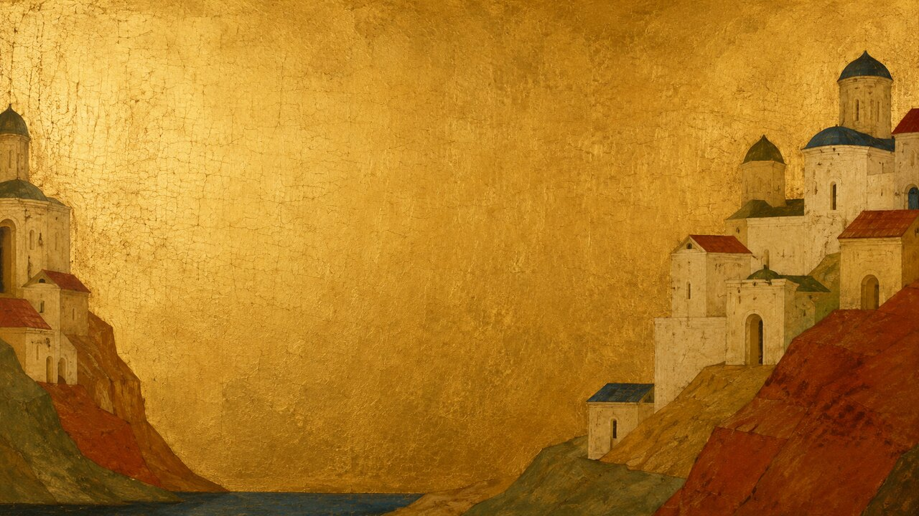
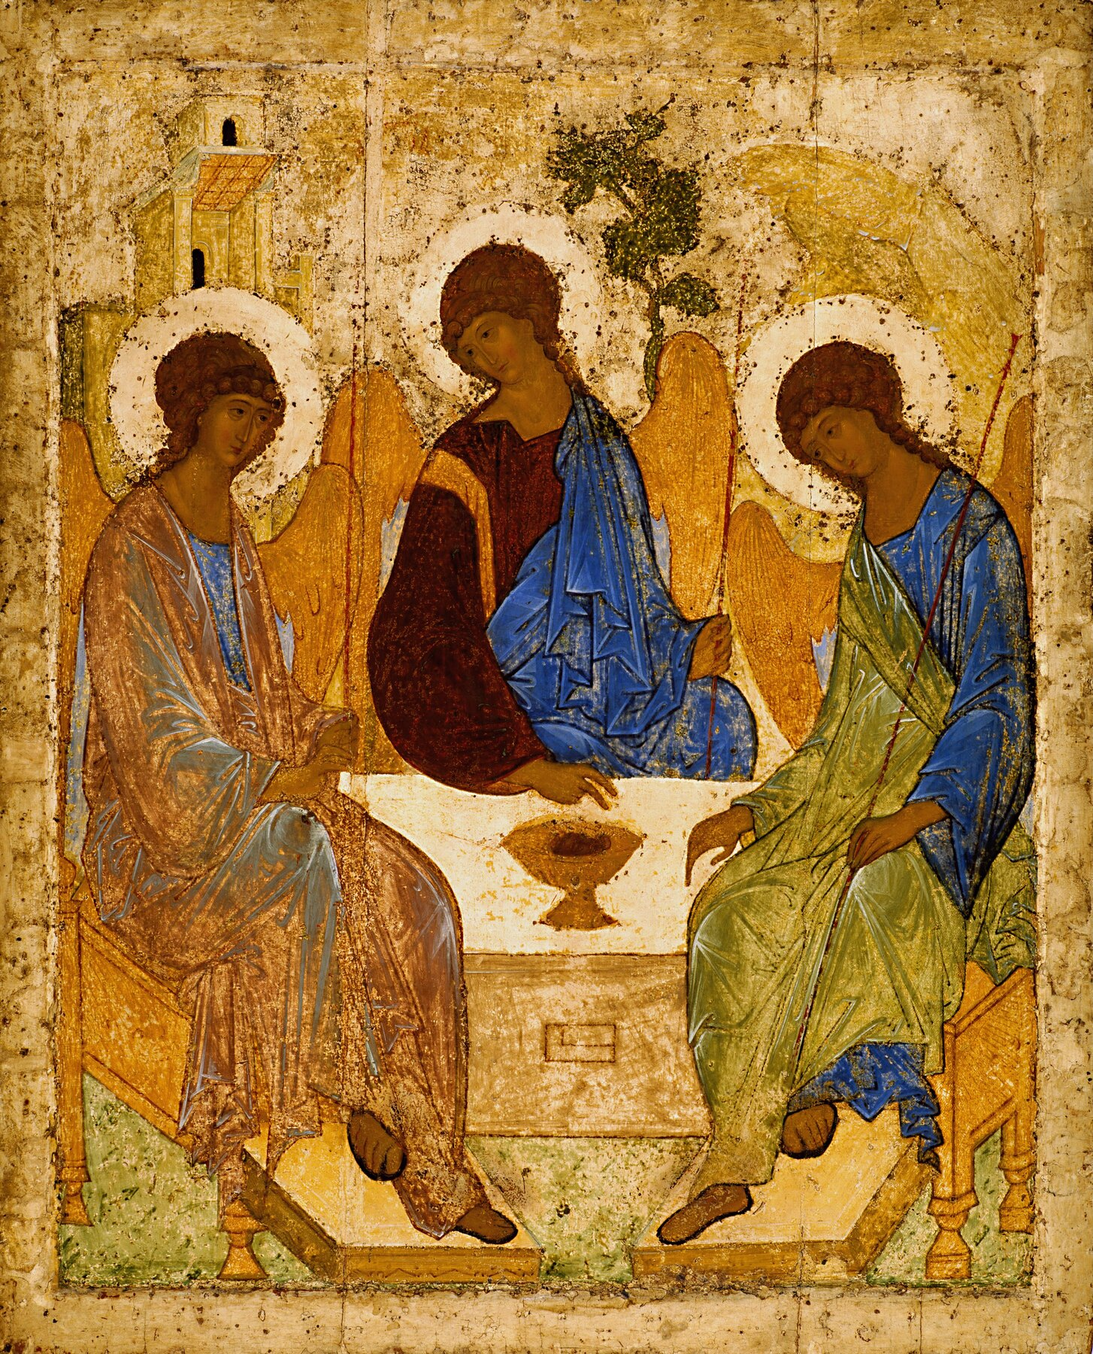
OUR FAMOUS ARTISTS | RUSSIAN ICONS
ANDREI RUBLEV
PEACE CAN BE A COMPOSITION
From fragmentary records to The Trinity
An order not centered on domination
Notes:
How did a monk whose birthplace, exact birth year, and appearance are unknown become the most celebrated painter of medieval Russia? Andrei Rublev left no autobiography, no letters, and no reliable portrait. The strongest evidence for his life consists of a few short chronicle entries naming him in major church projects. Yet his name has become inseparable from one image: The Trinity. Three angels sit quietly around a table. There is no theatrical action and no spectacular miracle. The real event is relational: three bodies incline toward one another, three gazes circulate, and a cup at the center connects difference into unity. Through limited documents, damaged works, and one six-hundred-year-old icon, this video asks how Rublev created an order not based on domination in an age marked by violence and political instability.
[Sources]
- https://www.tretyakovgallerymagazine.com/node/7196
- https://commons.wikimedia.org/wiki/File:Andrey_Rublev_-_Св._Троица_-_Google_Art_Project.jpg

Slide 2
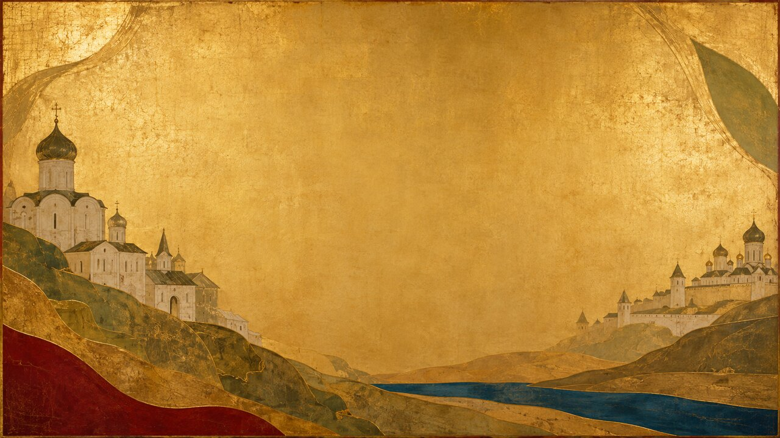
OUR FAMOUS ARTISTS | ANDREI RUBLEV
02
Moscow under the Mongol Shadow
1380
1382
1408
KULIKOVO
MOSCOW BURNED
EDIGU'S RAID
War and monastic expansion unfolded together.
Serenity was not an escape, but an alternative order.
1360s–1370s? | Moscow burned in 1382 | War returned in 1408
OUR FAMOUS ARTISTS
Notes:
Rublev was probably born sometime in the 1360s or 1370s, but neither the place nor his family background is known. The Rus’ principalities of his lifetime remained under the political and tributary system of the Golden Horde. The Battle of Kulikovo in 1380 enhanced Moscow’s prestige but did not end Mongol power. Tokhtamysh captured and burned Moscow in 1382. In 1408, the forces of Edigu attacked the region and burned the Trinity Monastery. At the same time, monasteries expanded, stone churches rose, and Moscow gradually became a political and religious center. Icons in this world were not wall decoration. They belonged to altars, iconostases, feast days, prayer, princely authority, and collective memory. Rublev’s serenity was therefore not an escape from history. It was an alternative order proposed from within an unstable world.
[Sources]
- https://whc.unesco.org/en/list/657/
- https://www.lavra.ru/languages/en/page4.php

Slide 3
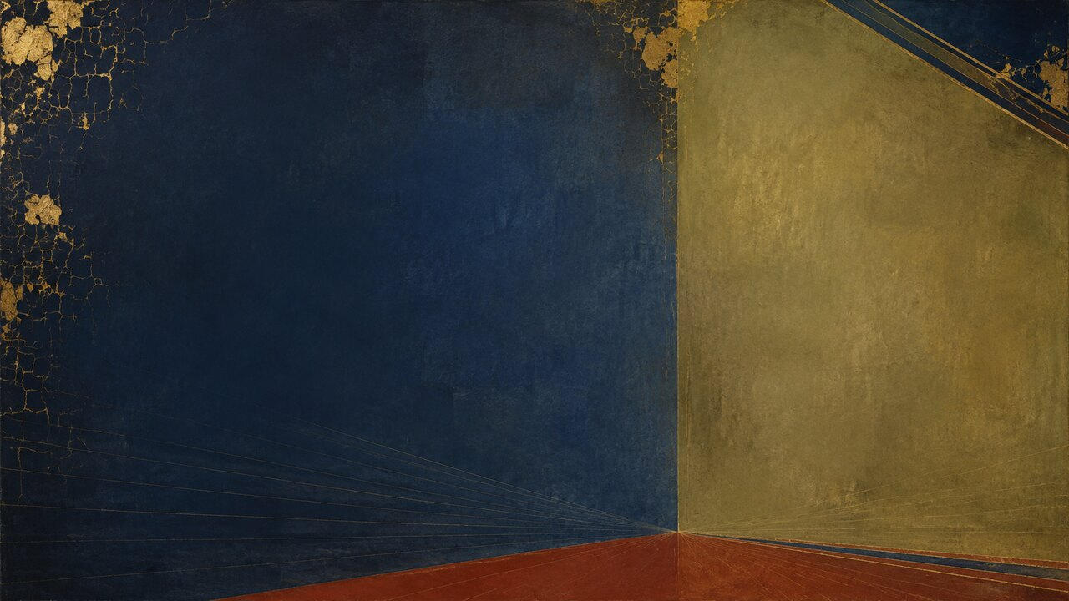
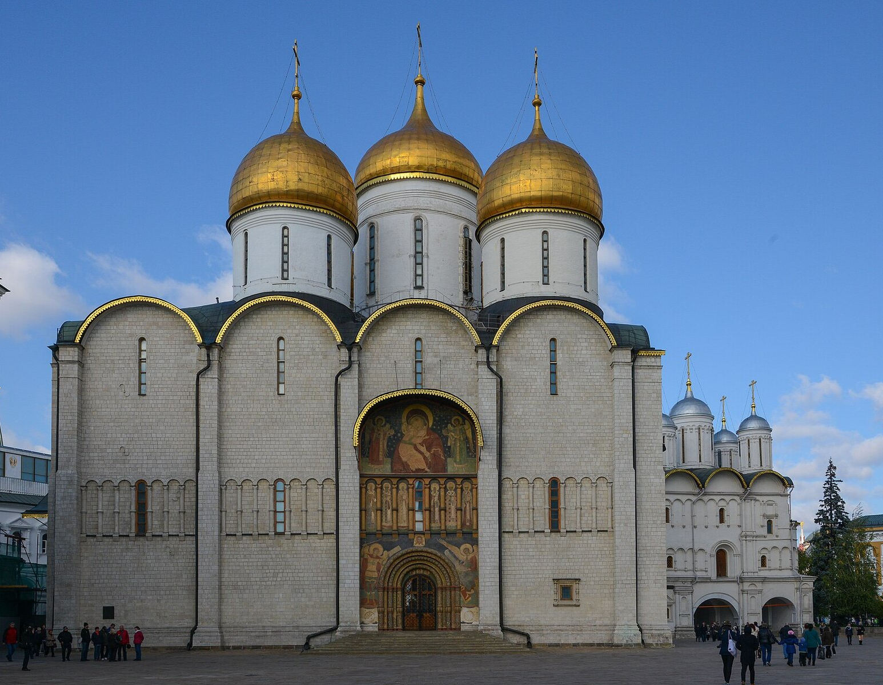
OUR FAMOUS ARTISTS | ANDREI RUBLEV
03
An Icon Is Not an Ordinary Portrait
WOOD
support
TEMPERA
luminous color
GOLD
nonordinary space
INVERSE PERSPECTIVE
opens outward
An icon is not a naturalistic portrait; it belongs to worship and collective memory.
OUR FAMOUS ARTISTS
Notes:
Rublev was a monk and an icon painter. In Eastern Christianity, an icon is not simply a picture that imitates external appearance. It makes sacred teaching visible within worship. The artist works inside established subjects, gestures, and symbols, yet can still transform the spiritual tone through proportion, line, color, and the relationships between figures. Icons also exist beyond painted panels—in fresco, mosaic, manuscript, metalwork, ivory, and textile. Rublev inherited a Byzantine visual language. Bodies are not primarily demonstrations of naturalistic weight. Space does not need to obey a single Renaissance vanishing point. Gold removes ordinary depth, while layered viewpoints and what is often called “reverse perspective” allow the image to open toward the person standing before it. Rublev’s innovation was not a rejection of tradition. He softened authority from within it, giving compassion to the gaze and attention to the act of one figure leaning toward another.
[Sources]
- https://whc.unesco.org/en/list/633/
- https://commons.wikimedia.org/wiki/File:Dormition_Cathedral_(19964269815).jpg

Slide 4
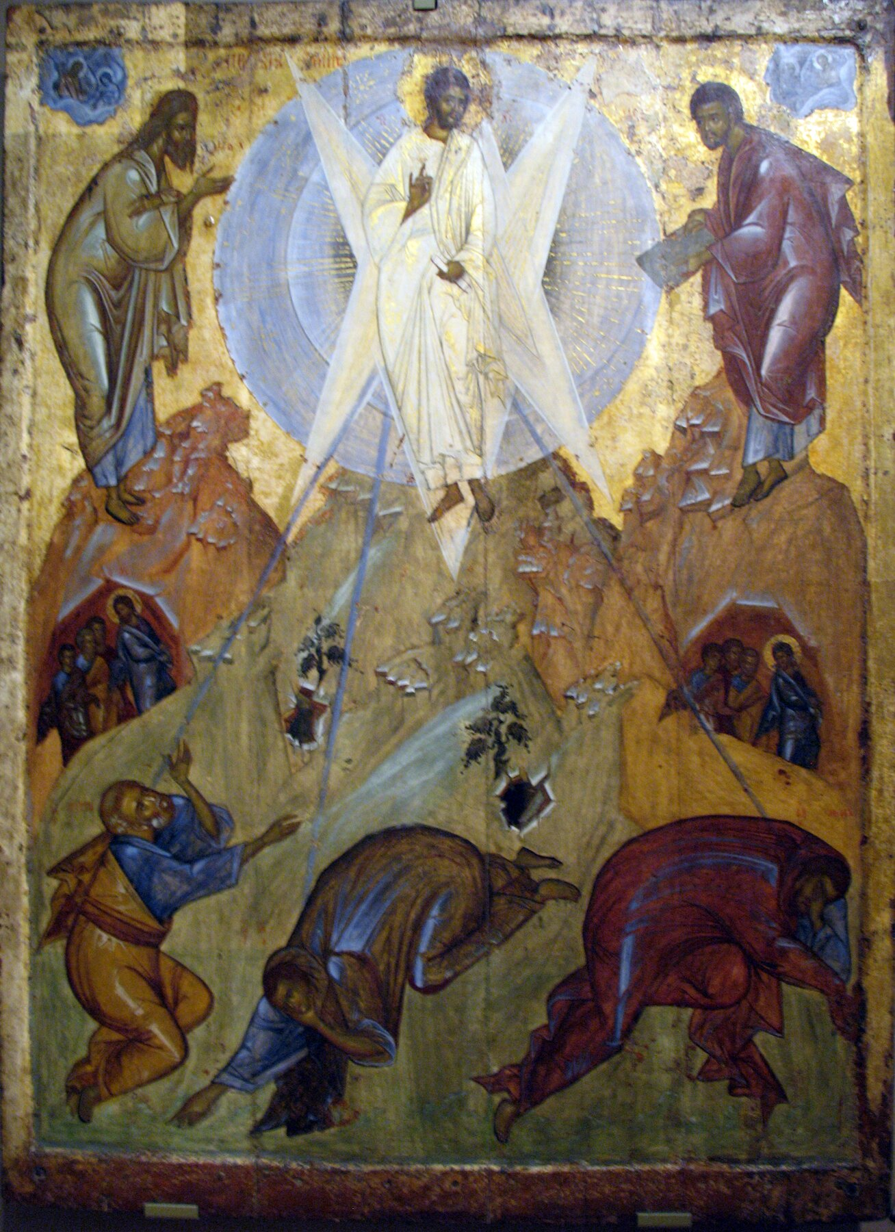
OUR FAMOUS ARTISTS | ANDREI RUBLEV
04
1405: Working beside Theophanes the Greek
1405
SHARED PROJECT
NOT A PROVEN PUPILAGE
THEOPHANES | FORCEFUL LIGHT
RUBLEV | GENTLE RESPONSE
1405 | Rublev worked with Theophanes; a formal teacher–pupil bond is unproved.
OUR FAMOUS ARTISTS
Notes:
Rublev first appears in a chronicle in 1405. He worked with Prokhor of Gorodets and the renowned Byzantine master Theophanes the Greek on the predecessor of the Cathedral of the Annunciation in the Moscow Kremlin. Rublev is named last. This may suggest that he was younger or held lower status, but the order alone cannot prove the division of labor. Theophanes is also often described as Rublev’s teacher, although no surviving document establishes a formal apprenticeship. What is certain is that Rublev worked beside a mature Byzantine master. Theophanes often built figures with rapid strokes, severe faces, and intense flashes of light. Rublev’s later language tends toward brighter color, continuous contours, and postures that seem to listen rather than command. The 1405 building and its murals did not survive. Scholars still debate whether parts of the later iconostasis preserve works from the original project and whether individual panels belong to Rublev or his wider circle. A documented commission does not automatically turn every surviving object into the autograph work of one master.
[Sources]
- https://www.tretyakovgallerymagazine.com/node/7196
- https://commons.wikimedia.org/wiki/File:1400-10_Theophanes_the_Greek_Transfiguration_anagoria.JPG

Slide 5
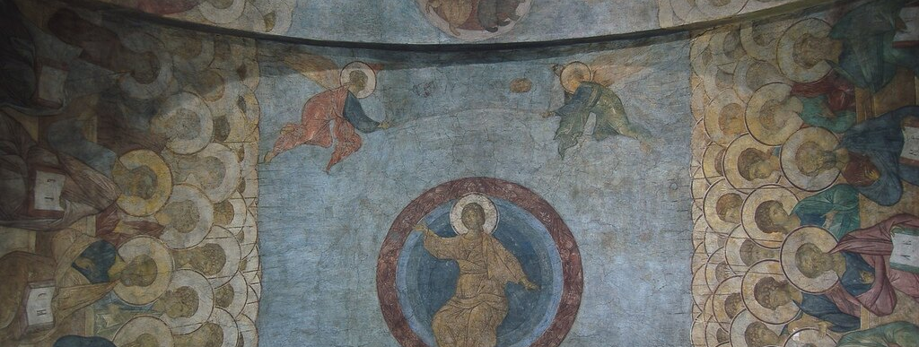
OUR FAMOUS ARTISTS | ANDREI RUBLEV
05
1408: Can a Last Judgment Be about More Than Fear?
DOCUMENTED · DATED · IN SITU
Yet monumental fresco remained a team project
1408 | Judgment remains, but fear no longer defines the final order.
OUR FAMOUS ARTISTS
Notes:
In 1408, chronicles record that Rublev and Daniil Chyorny painted the Cathedral of the Dormition in Vladimir. UNESCO also identifies their participation, and portions of the Last Judgment and other frescoes remain in the building. This is one of the few core Rublev projects supported by documentation, a firm date, and surviving work in its original architectural setting. Yet a cathedral mural cycle required a workshop. We cannot assign every face or fold of drapery to one painter. Images of the Last Judgment often emphasize punishment and terror. The surviving figures in Vladimir instead appear comparatively gentle, bright, and orderly. Many art historians have interpreted the cycle as shifting attention from fear toward salvation and the restoration of cosmic order. That mood is an interpretation drawn from visual form, not an emotion stated by the chronicle. Still, it offers an important key to Rublev: he did not abolish judgment, but he refused to let fear become the image’s final order.
[Sources]
- https://whc.unesco.org/en/list/633/
- https://commons.wikimedia.org/wiki/File:Rublev_fresco,_Vladimir_cathedral_02.jpg

Slide 6
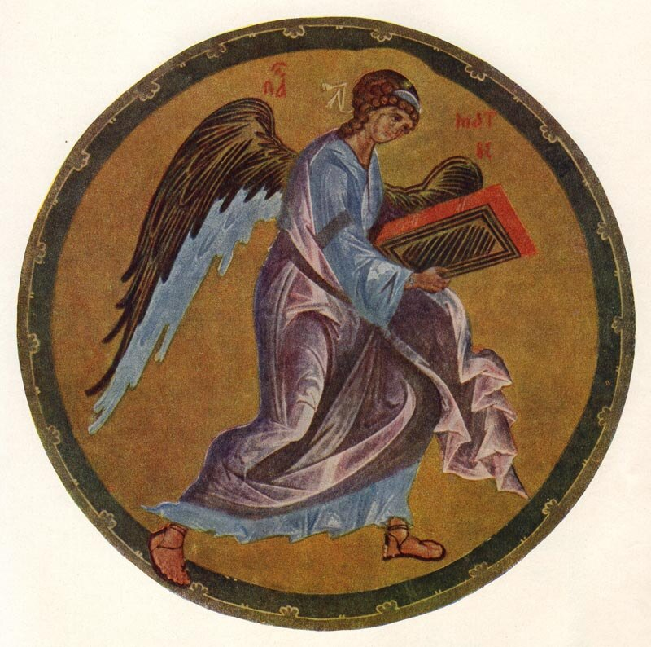
OUR FAMOUS ARTISTS | ANDREI RUBLEV
06
A Gospel Book and the Invisible Workshop
SCRIBE
GILDING
DRAWING
ORNAMENT
ATTRIBUTED TO RUBLEV AND HIS CIRCLE
A manuscript joins writing, drawing, gilding, and ornament in one workshop ecology.
OUR FAMOUS ARTISTS
Notes:
The Khitrovo Gospel is celebrated for eight miniatures, elaborate initials, and ornament. The image most often connected with Rublev is the symbol of Matthew: a winged figure holding a scroll within a balanced circular design. UNESCO associates the miniatures with Rublev and artists around him, but scholars have not reached agreement on individual hands. Theophanes, Daniil, or several workshop members may have participated. A manuscript was normally a collaborative object made by scribes, painters, gilders, and decorators. Its importance is precisely that it takes us beyond the myth of the isolated genius. Compositional balance, color, and theological symbols circulated between book workshops, cathedral walls, and icon screens.
[Sources]
- https://www.unesco.org/en/memory-world/khitrovo-gospel
- https://commons.wikimedia.org/wiki/Category:Khitrovo_Gospels

Slide 7
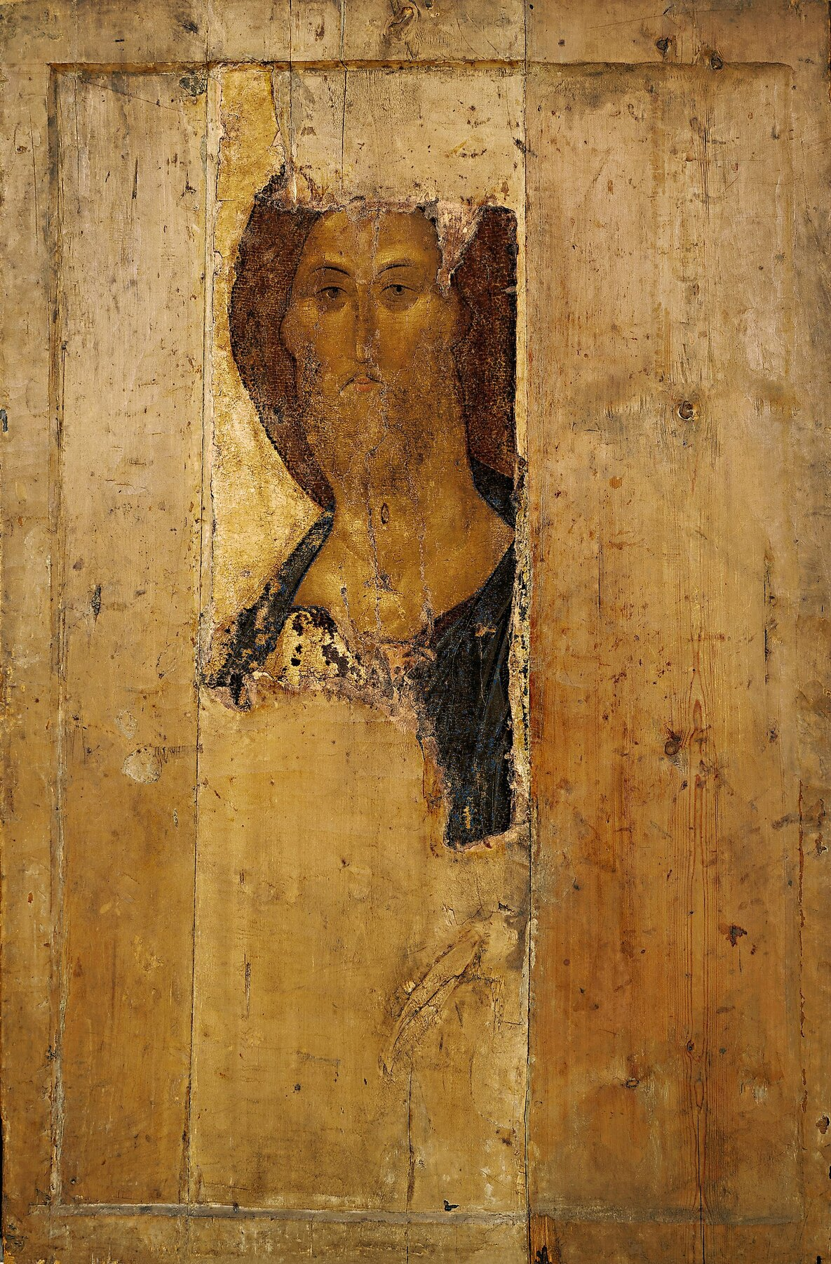
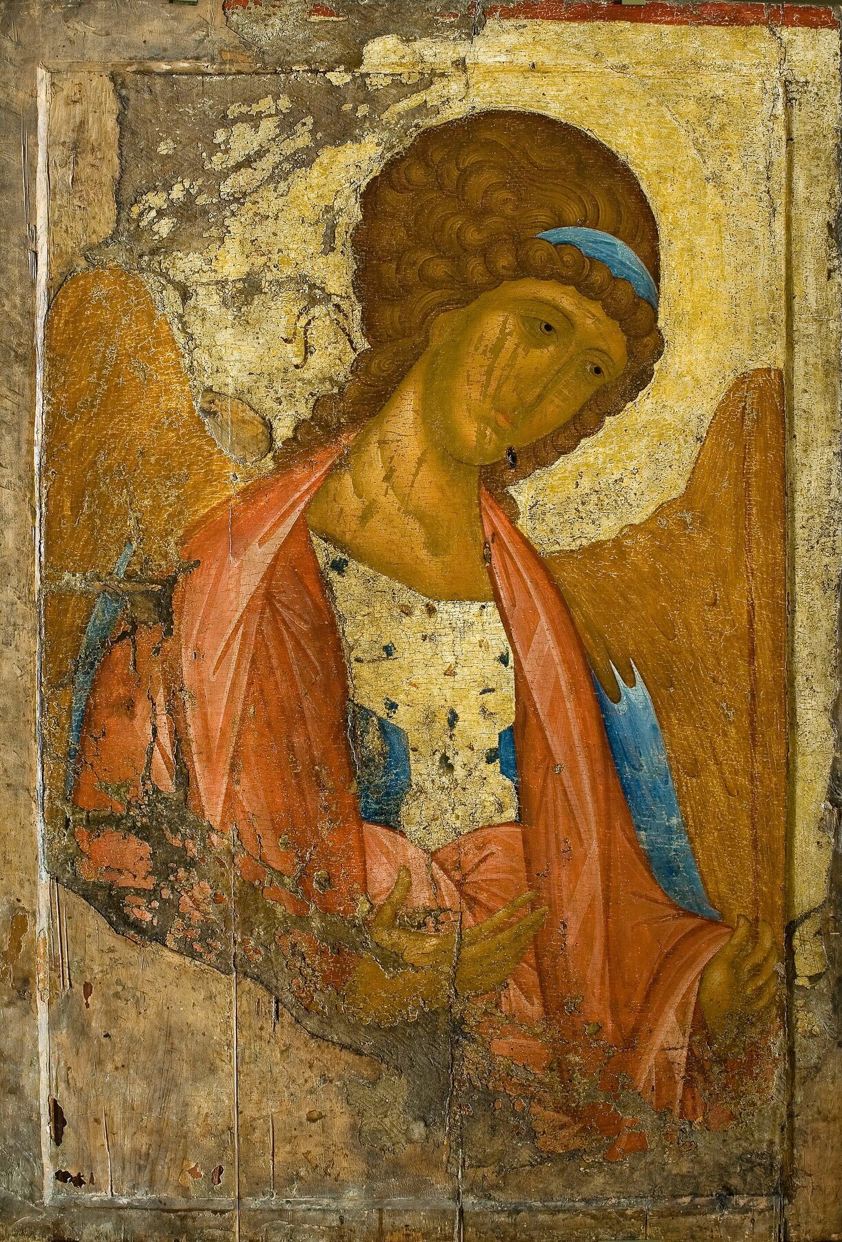
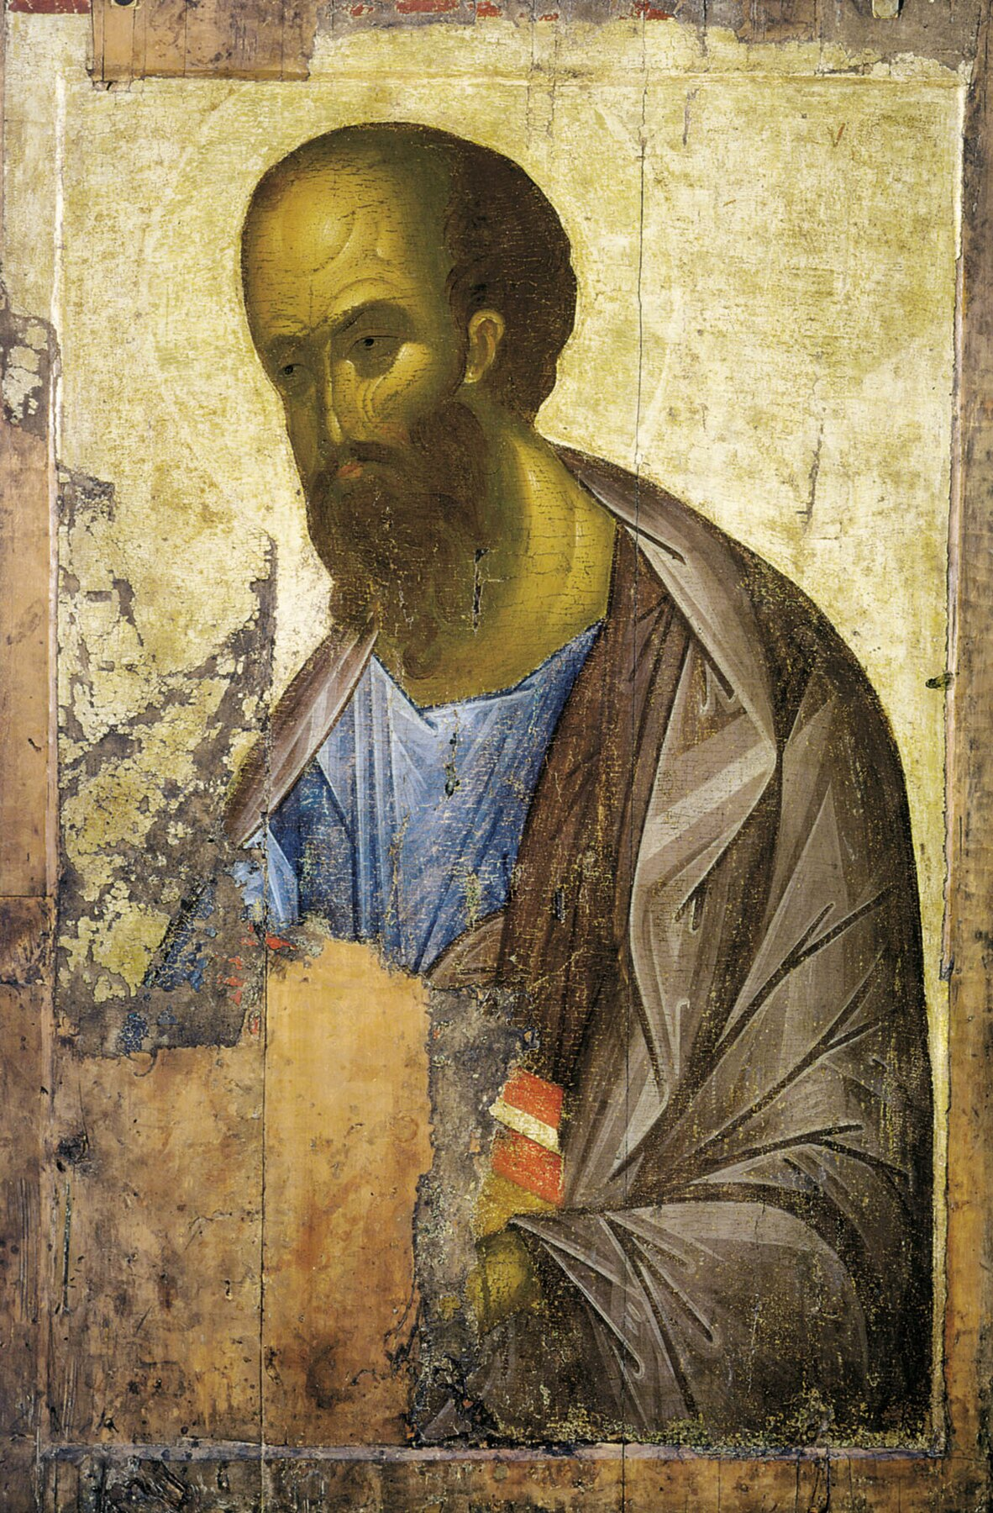
OUR FAMOUS ARTISTS | ANDREI RUBLEV
07
The Zvenigorod Deesis: A Wounded Face and a Disputed Hand
SAVIOUR
ARCHANGEL MICHAEL
SAINT PAUL
FOUND IN 1918 | TECHNICAL STUDY REOPENED AUTHORSHIP, 2015–16
Saviour · Archangel Michael · Saint Paul | A traditional attribution under review.
OUR FAMOUS ARTISTS
Notes:
In 1918, an expedition preserving early Russian painting found three badly damaged icons near the Dormition Cathedral in Zvenigorod: Saviour, Archangel Michael, and Apostle Paul. They were understood as surviving parts of a larger Deesis, in which sacred figures turn toward Christ in intercession. The Saviour is the most damaged and perhaps the most unforgettable. Losses concentrate attention on the eyes of Christ: authoritative without coldness, as if the gaze recognizes both human weakness and human possibility. The group became a classic example of the Rublev style, but no document names its author. Technical research conducted in 2015 and 2016 examined underdrawing, pigment layers, and working methods and questioned whether all three panels were painted by Rublev himself. They may belong to a broader Byzantine-Russian circle and may involve more than one painter. Scientific examination does not diminish the images. It changes the question. Are we searching for the hand of a celebrity, or trying to understand a shared visual world?
[Sources]
- https://commons.wikimedia.org/wiki/Category:Zvenigorodskiy_chin
- https://www.tretyakovgallerymagazine.com/node/7196

Slide 8
OUR FAMOUS ARTISTS | ANDREI RUBLEV
08
The Trinity: Reducing a Story to Relationship
HOUSE
hospitality / salvation
TREE
Mamre / life / cross
MOUNTAIN
revelation / ascent
CUP
meal / sacrifice
c. 1411 OR c. 1425–1427
Rublev reduces narrative until the relationship among three angels becomes the event.
OUR FAMOUS ARTISTS
Notes:
Rublev’s most famous and most securely accepted work is The Trinity, also called the Old Testament Trinity. Painted in tempera across joined wooden boards and approximately 141.5 centimeters high, it was not a small object for private devotion. Its date remains debated. One theory places it around 1411 for an earlier wooden church. Another dates it to approximately 1425–1427, when the stone Trinity Cathedral and its iconostasis were decorated. The question remains open. The subject comes from Genesis 18, when Abraham receives three mysterious visitors by the oak of Mamre. Traditional scenes include Abraham, Sarah, servants, food, and architecture. Rublev removes almost all narrative action, leaving only three angels, the cup, and a house, tree, and mountain. The story becomes concentrated into relationship. The house can evoke hospitality and salvation; the tree recalls the oak of Mamre, the tree of life, and the Cross; the mountain can suggest revelation and spiritual ascent. The cup connects the meal with sacrifice.
[Sources]
- https://www.tretyakovgallerymagazine.com/node/7196
- https://commons.wikimedia.org/wiki/File:Andrey_Rublev_-_Св._Троица_-_Google_Art_Project.jpg

Slide 9
OUR FAMOUS ARTISTS | ANDREI RUBLEV
09
How Three Angels Form a Circle
HEADS · WINGS · DRAPERY
CUP · GESTURES · GAZES
NOT A CODEBOOK—A RELATIONAL RHYTHM
Unity does not erase difference; it makes difference responsive.
OUR FAMOUS ARTISTS
Notes:
The heads, wings, and bodies of the angels create a circular rhythm around the table. This is not a geometric circle drawn with instruments. It emerges from inclined heads, flowing gazes, and the curves of the garments. A common interpretation identifies the left, center, and right angels as Father, Son, and Holy Spirit. Yet theological traditions do not agree on every identity, gesture, or color. Rather than treating each hue as a secret code, we can observe how the figures are both similar and distinct. They face one another, but none overpowers the other two. The cup occupies the relational center. The eye travels from cup to gesture, face, wing, and back again. No single figure possesses the composition. Rublev presents unity as dynamic—not the removal of difference, but difference held in mutual response.
[Sources]
- https://www.tretyakovgallerymagazine.com/node/7196
- https://commons.wikimedia.org/wiki/Category:Holy_Trinity_Icon_(Andrej_Rublëv)

Slide 10
OUR FAMOUS ARTISTS | ANDREI RUBLEV
10
The Place Reserved for the Viewer
PICTURE DEPTH
↘ ↙
←
VIEWER
THE TABLE OPENS OUTWARD
THE VIEWER IS INVITED CLOSER
The outward-opening table gives the viewer a place within the relation.
OUR FAMOUS ARTISTS
Notes:
The near side of the table remains open. Linear perspective normally sends space backward toward a vanishing point and leaves the viewer outside. Here, the diagonals of table and seats appear to expand outward, bringing the visual structure toward the person standing in front of the icon. This effect, often called reverse perspective, works with the gold ground to make the sacred meal feel open rather than remote. The viewer is not merely watching from a safe distance; the composition seems to invite participation. We do not need to invent a lost “fourth chair.” What matters is that the image does not close itself. Through gaze, gesture, and spatial construction, it preserves the possibility that the person before it can enter the relationship. In 1551, the Stoglavy Council instructed painters to depict the Trinity according to ancient models and the manner of Rublev. This did not declare one panel the only official answer, but it shows that by the sixteenth century his visual solution had become an authoritative model.
[Sources]
- https://www.tretyakovgallerymagazine.com/node/7196
- https://commons.wikimedia.org/wiki/Category:Holy_Trinity_Icon_(Andrej_Rublëv)

Slide 11
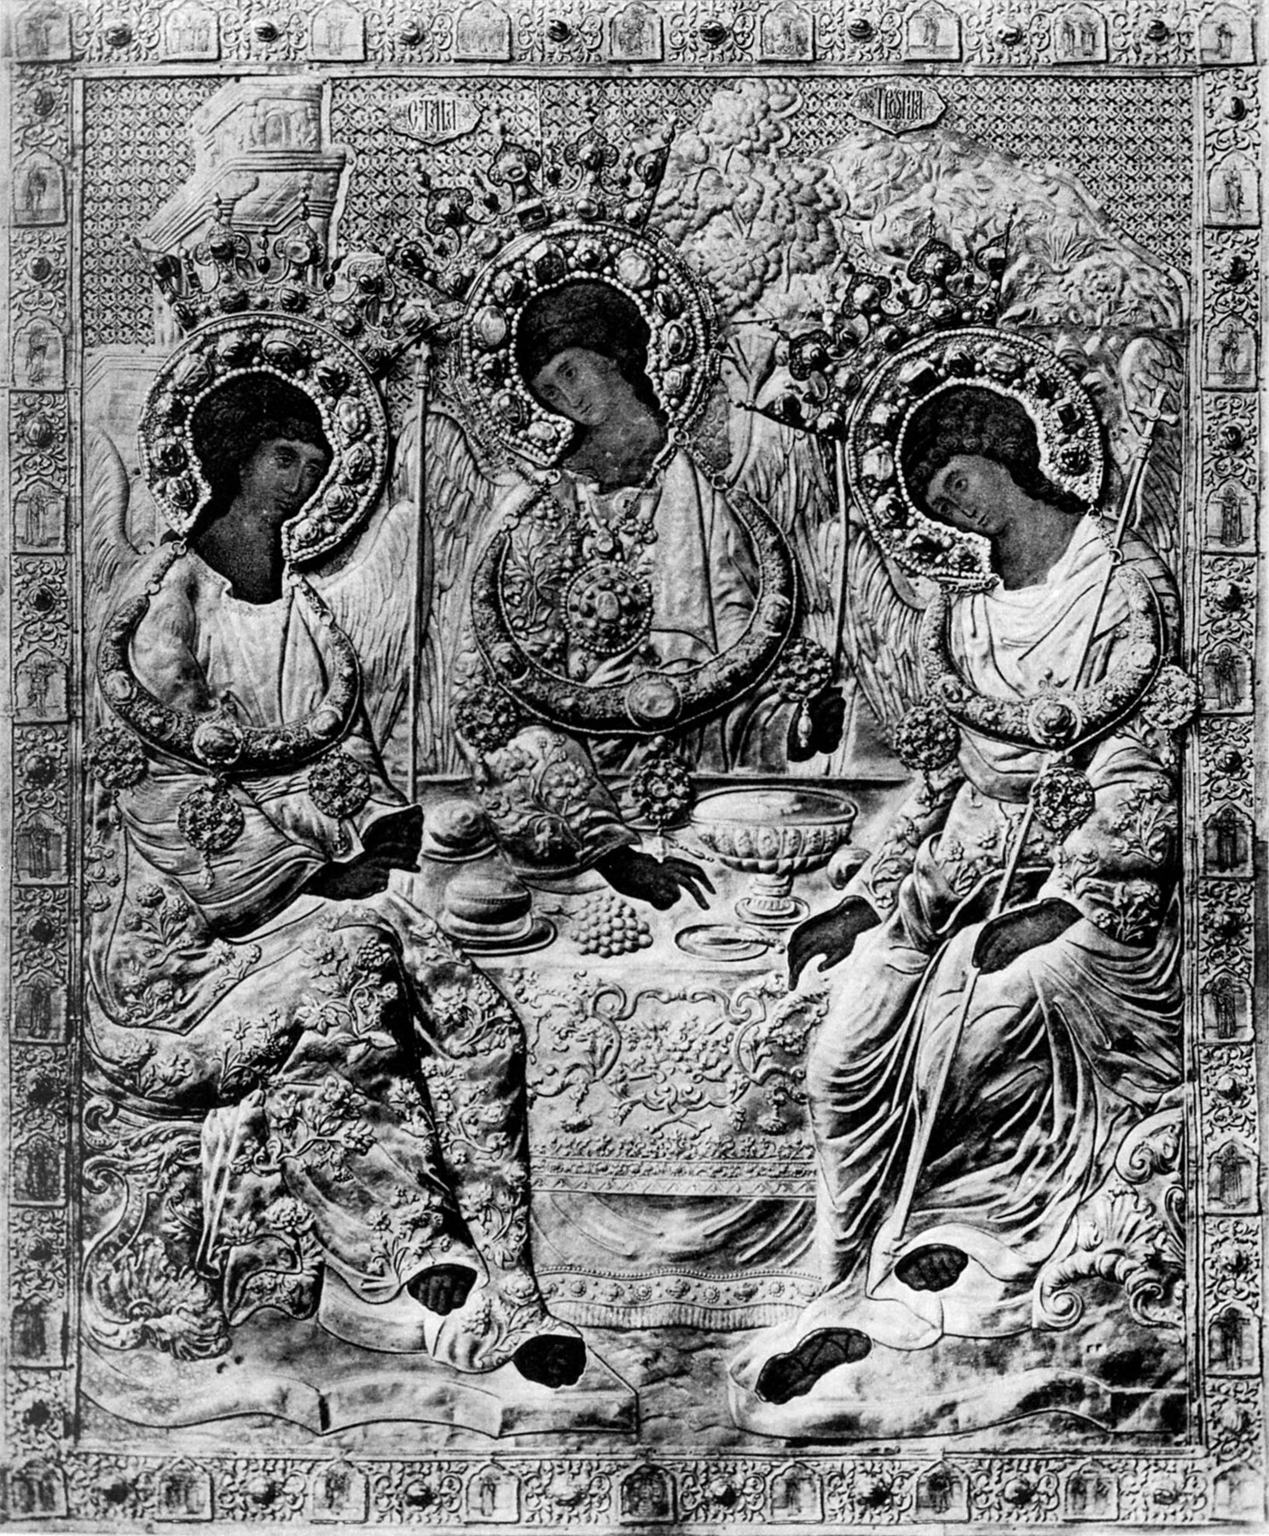
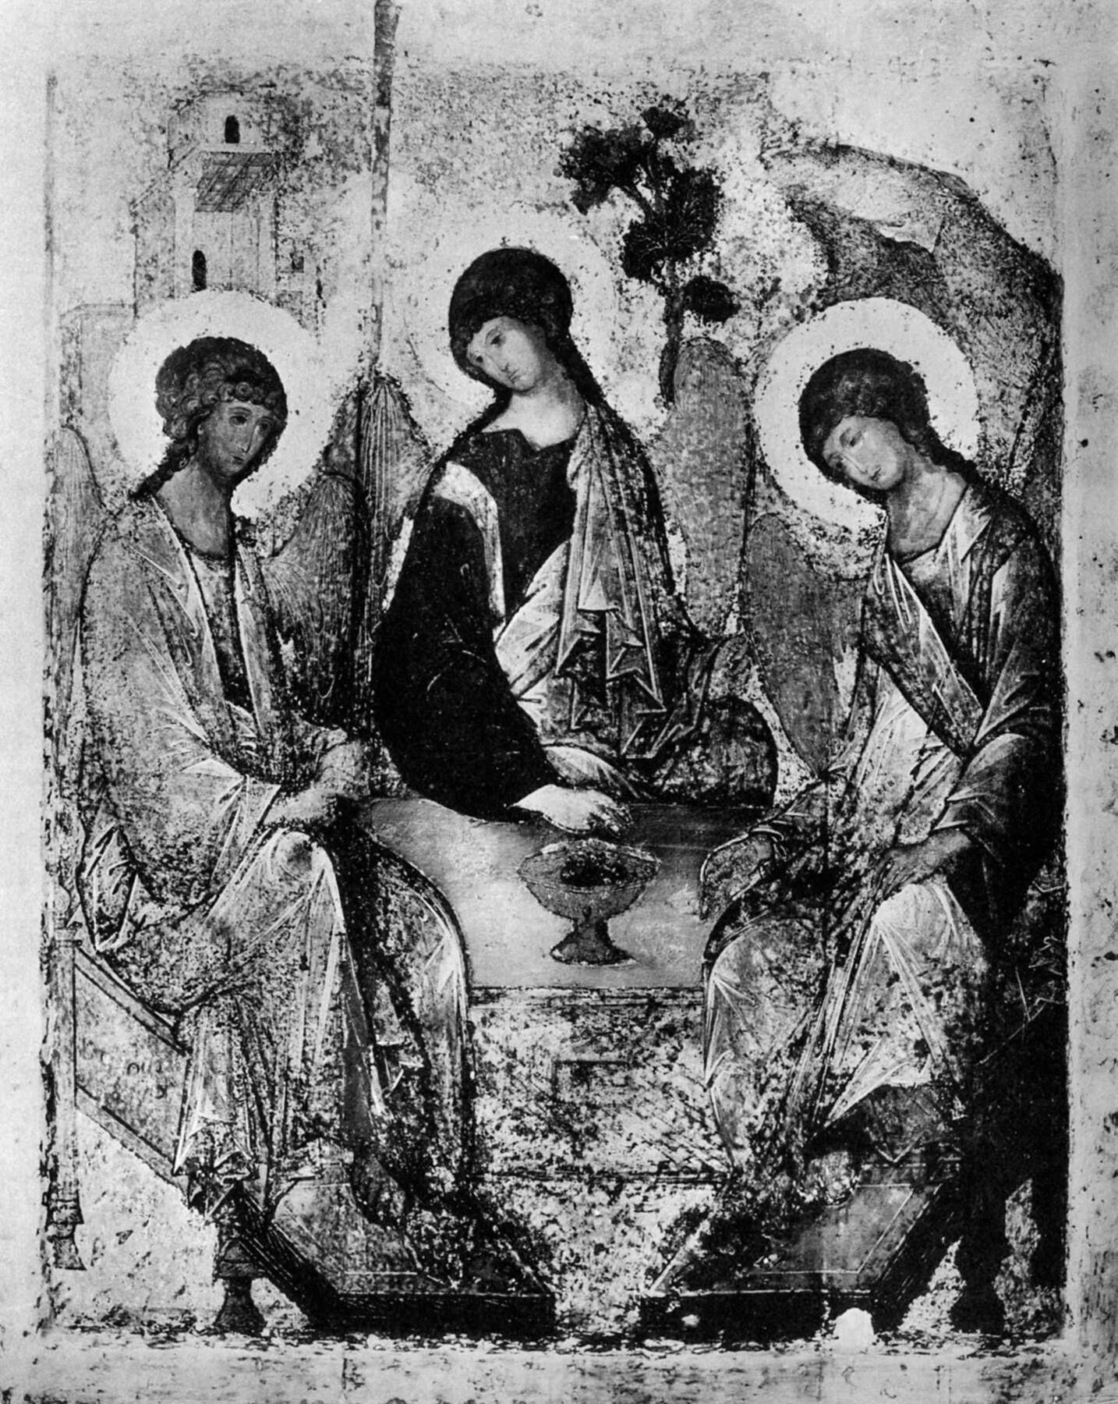
OUR FAMOUS ARTISTS | ANDREI RUBLEV
11
Which Layer of The Trinity Do We See Today?
BEFORE 1904 | RIZA
SURFACE IN CLEANING
WHAT WE SEE TODAY
ORIGINAL PAINT + AGING + LOSS + RESTORATION
What we see is original paint, aging, loss, and successive restoration together.
OUR FAMOUS ARTISTS
Notes:
The Trinity did not reach us in untouched fifteenth-century condition. Centuries of candle smoke, darkened coatings, temperature and humidity changes, repainting, and renewal altered its surface. Precious metal coverings donated by rulers and worshippers once concealed most of the composition, leaving mainly faces and hands visible. In 1904–1905, Vasily Guryanov uncovered sections of early color but also repainted areas according to the practice of his time. In 1918–1919, a professional team more systematically distinguished original paint, later layers, and losses. The blue, green, and ochre we see today are not simply the original colors revealed by wiping away dirt. They belong to a complex surface formed by Rublev’s pigments, material aging, damage, and successive conservation campaigns. Restoration brought Rublev into modern art history, but it also reminds us that to look at an ancient work is to look at the history of its concealment, survival, and rediscovery.
[Sources]
- https://commons.wikimedia.org/wiki/File:Rublev_trinity_riza.jpg
- https://commons.wikimedia.org/wiki/File:Rublev_troitsa_raschistka.jpg

Slide 12
OUR FAMOUS ARTISTS | ANDREI RUBLEV
12
Tarkovsky: When Missing History Becomes Cinema
1966
FILM ≠ DOCUMENTARY BIOGRAPHY
VIOLENCE · SILENCE · CREATION · MORAL RESPONSIBILITY
1966 | Tarkovsky’s film is an artistic meditation, not an illustrated biography.
OUR FAMOUS ARTISTS
Notes:
In 1966, Andrei Tarkovsky completed the film Andrei Rublev. It is not a documented biography transferred to the screen. The vow of silence, the young bell caster, and many episodes are artistic inventions built within the gaps of the historical record. The film’s real subject is how an artist continues to create amid violence, political power, and crisis of faith. Most of the film is in black and white. At the end, the images turn to color, and Rublev’s icons appear as if revealed from the suffering world that preceded them. The film was restricted after completion. An approximately 205-minute early cut was suppressed after limited screenings. In 1969, a version screened out of competition at Cannes and received the FIPRESCI Prize. Tarkovsky’s preferred version of about 183 minutes received a limited Soviet release in 1971. The film cannot replace Rublev’s history, but it transformed modern imagination. Rublev became not only a medieval monk, but a cultural model for the artist confronting violence and moral responsibility.
[Sources]
- https://www.criterion.com/films/300-andrei-rublev

Slide 13
OUR FAMOUS ARTISTS | ANDREI RUBLEV
13
Does an Icon Belong in a Church or a Museum?
MUSEUM
CHURCH
CLIMATE CONTROL
RESEARCH · CONSERVATION
WORLD HERITAGE
LIVING VENERATION
PRAYER · COMMUNITY
SYMBOLIC RETURN
OWNERSHIP ≠ FREEDOM FROM CARE
1929 museum | 2022–23 transfer debate | 2024 Trinity Lavra
OUR FAMOUS ARTISTS
Notes:
The modern fate of The Trinity places worship and conservation at the same table. In 1929, the icon entered the State Tretyakov Gallery and was preserved under controlled conditions. In 2022, it was temporarily sent to the Trinity Cathedral for veneration, prompting conservators to warn about risks to the wooden boards, ground, paint layers, and stability of the environment. In 2023, the Russian government decided to transfer the icon to the Russian Orthodox Church. In June 2024, it returned to the Trinity Lavra of St Sergius in a specially designed protective case. There is no simple answer. To treat the icon only as a museum object can sever it from liturgy and living prayer. Yet if symbolic return overrides material conservation, a six-hundred-year-old panel may suffer irreversible damage. The same work can be a sacred image, a national symbol, and part of world cultural heritage. For that reason, ownership can never remove the responsibility to preserve.
[Sources]
- https://lavra.ru/lavra-news/svyataya-troitsa-prepodobnogo-andreya-rublyeva-vernulas-v-troitse-sergievu-lavru/
- https://whc.unesco.org/en/list/657/

Slide 14
OUR FAMOUS ARTISTS | ANDREI RUBLEV
14
Ending: Peace Can Be a Composition
PEACE CAN BE A COMPOSITION.
FEAR → HOPE
MAJESTY → MERCY
DIFFERENCE → RESPONSE
HOW CAN DIFFERENCE COEXIST WITHOUT CONQUEST?
Peace can be a composition: no figure conquers the other two.
OUR FAMOUS ARTISTS
Notes:
Rublev matters for more than the title “Russia’s greatest icon painter.” He shows that innovation does not always require rejecting tradition. Within established subjects, figure types, and material procedures, he changed spiritual emphasis through color, contour, gaze, and relationship. A Last Judgment could contain less terror and more hope for restored order. Christ could appear authoritative and merciful. Three angels could remain distinct without one conquering the other two. Rublev also forces us to rethink authorship. If frescoes, manuscripts, and iconostases were produced with workshops, does the master become less important? Perhaps the opposite is true. What survived was not simply the flash of an isolated genius, but a visual ethic that could be learned, shared, and transformed by a community. Peace does not have to look like a celebration after war. It can exist in the way one head inclines toward another, the way one blue answers another garment, and the way a table preserves an opening for a stranger. Rublev did not answer in words how difference can face difference without conquest. He seated three angels at one table and allowed gaze, gesture, and color to answer for him.
[Sources]
- https://www.tretyakovgallerymagazine.com/node/7196
- https://whc.unesco.org/en/list/633/

Slide 15
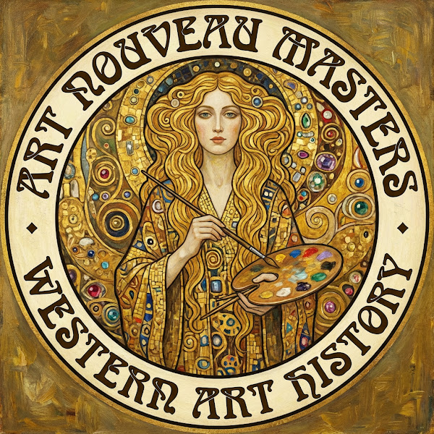
Notes:
Thank you for watching. Subscribe to Our Famous Artists, and join us as we continue along the timeline of art history.
[Sources]
- Channel end card; no external sources.

